Slide 1

Introductions to MVC/REST APIs
Mr. Krishnaraj

Slide 2

Todays Agenda
1
MVC
2
Controllers
3
JSON
4
API Development (REST)
6
Assignments
5
Use Cases
7
Debrief

Slide 3

MVC (Model-View-Controller)
It's a design pattern used in software engineering for developing applications (especially web and desktop apps) that separates concerns across three interconnected components called Model, View and Controller.
1. Model :
Model represents the data and the business logic of the application.
Model knows everything about the data, how to process it, and how to store it.
Model is responsible for,
Manages data and logic
Interacts with the database
Implements business rules

Slide 4
MVC (Model-View-Controller)
2. View :
View is responsible for presenting data to the user.
It defines how the application looks, not how it works.
We can think about the View as the face of the application where it shows data and collects user input visually.
View is responsible for,
Display Data from the Model
Render UI Components
Collect User Input
Send User Actions to the Controller

Slide 5
MVC (Model-View-Controller)
3. Controller :
Controller acts as a middleman between the View (user interface) and the Model (data and logic).
It handles user input, performs necessary processing, and decides what to do next.
It can be considered as a traffic cop who decides where requests go, what logic runs, and what gets shown.
Key responsible for Controller are,
Handle User Input
Process Requests
Update the View
Control Application Flow

Slide 6
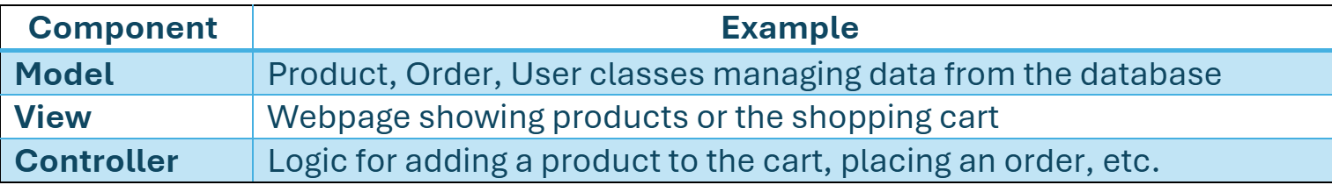
MVC (Model-View-Controller)
Web Framework using MVC :
ASP.NET MVC
Django (technically MTV, like MVC)
Ruby on Rails
Laravel (PHP)
Example:

Slide 7
JSON- JavaScript Object Notation
It is a lightweight, text-based format used for exchanging data between a server and a client or between different parts of an application.
It represents data as simple key-value pairs organized into objects and arrays, making it easy to read and write for both humans and machines.
Json Syntax:
Here,
“Value” can be Strings (in double quotes), Numbers (integer or float), Objects (another JSON object), Arrays, Booleans (true or false) and Null (null) .

Slide 8
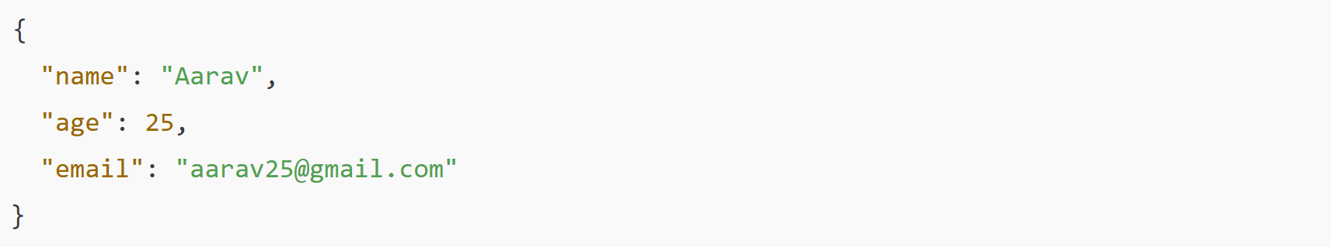
JSON- JavaScript Object Notation
Example:
JSON Array :
JSON Array is an ordered list of values enclosed in square brackets [ ]. The values inside a JSON array can be of any valid JSON type: strings, numbers, objects, arrays, booleans or null.

Slide 9
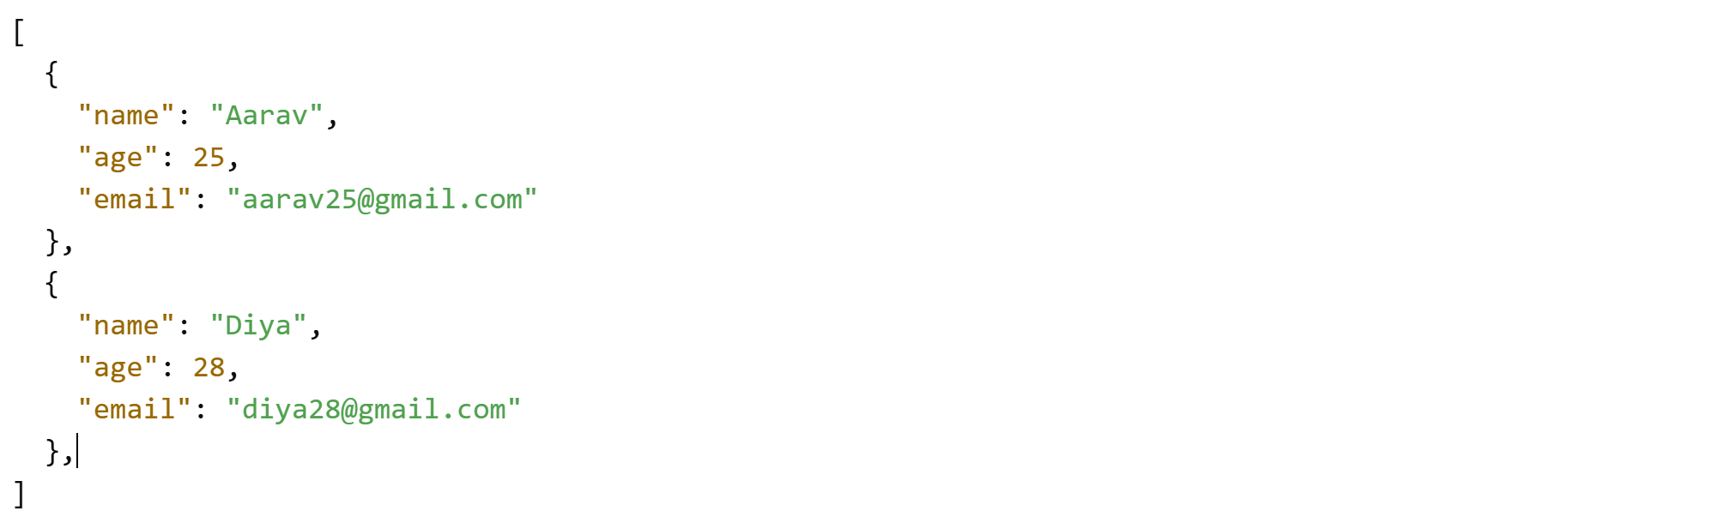
JSON- JavaScript Object Notation
Array of JSON Objects:
An array of JSON objects is simply a list ([]) containing multiple JSON objects ({}).

Slide 10
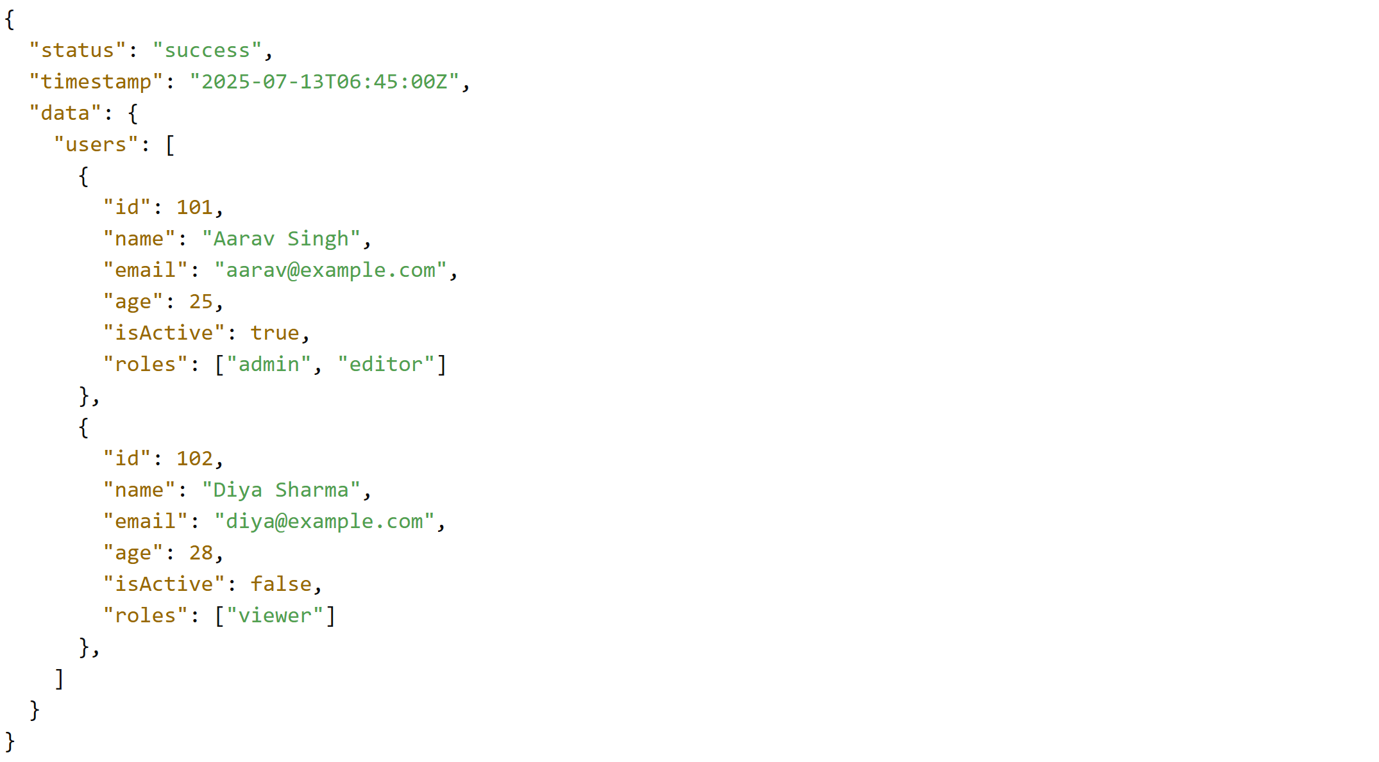
JSON- JavaScript Object Notation
Example:
user data from the server to the client.

Slide 11
REST API
A REST API (Representational State Transfer Application Programming Interface) is a widely used web service that allows systems to communicate over the internet using standard HTTP methods such as GET, POST, PUT, and DELETE.
It treats data as resources, which can be accessed and manipulated using unique URLs called endpoints.
REST APIs are stateless, meaning each request is independent. Data is typically exchanged in JSON.
Features:
Platform Independent
Standard Communication
Statelessness
Supports CRUD Operations
Secure Access

Slide 12
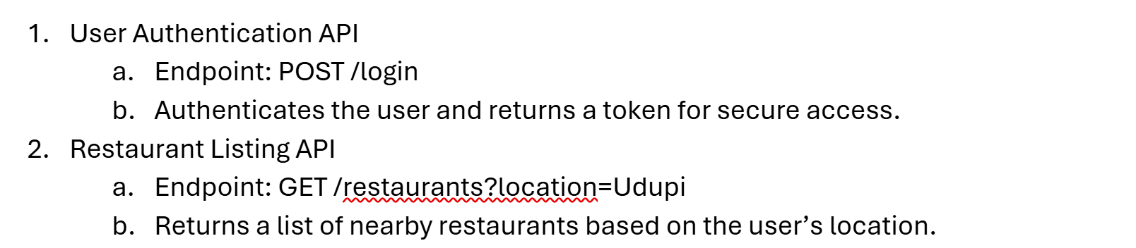
REST API
Use Case: Online Food Delivery App (like Swiggy or Zomato)

Slide 13
Debrief
Controllers
MVC
JSON
REST APIs
Use cases

Slide 14
📘 Official Resources (High-Quality & Up-to-Date)
References

Slide 15

Thank you

